Slide 1
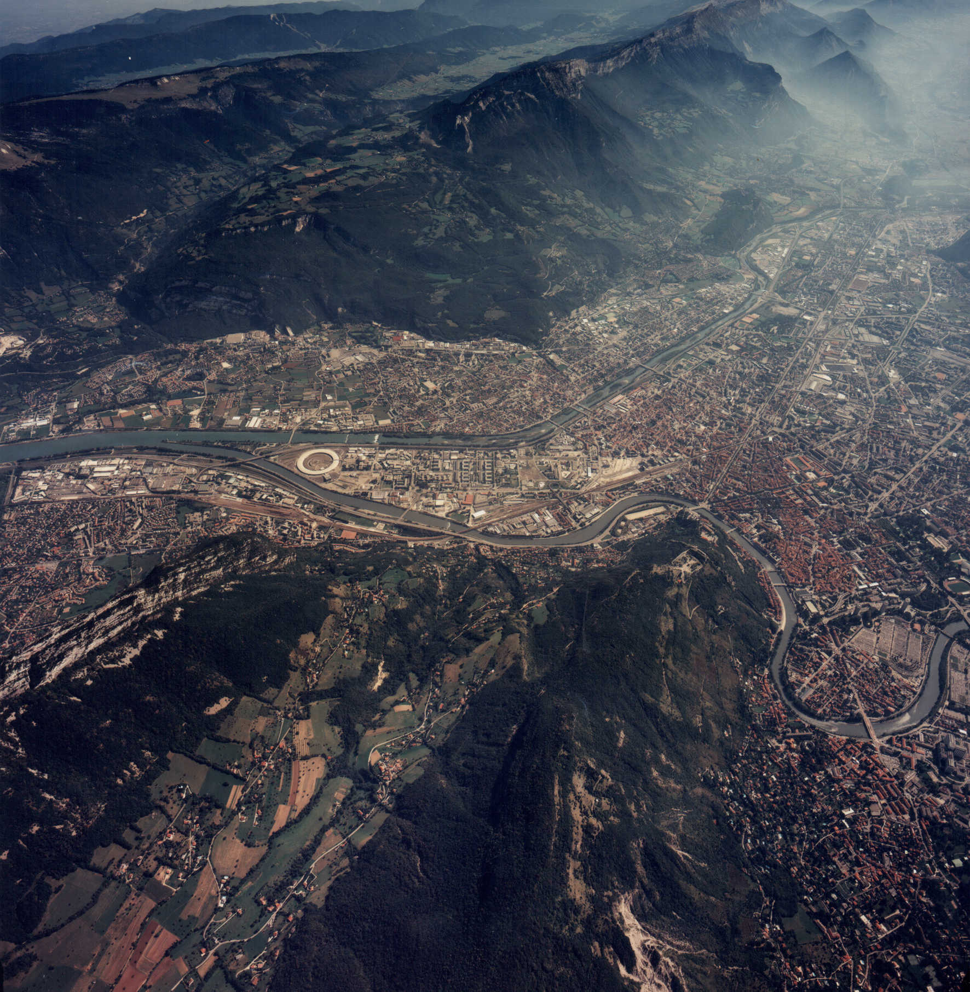
Welcome to the ESRF

Slide 2
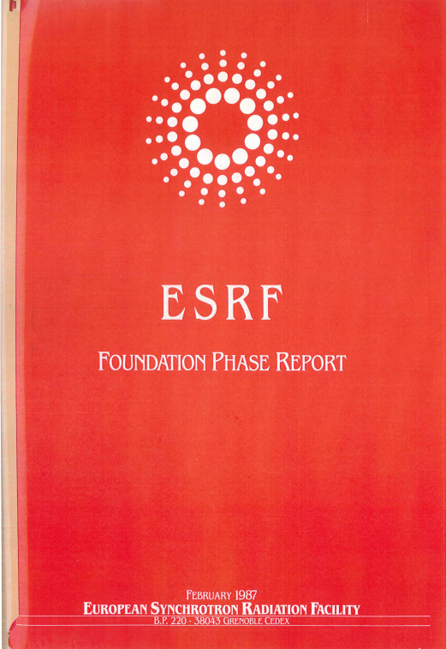
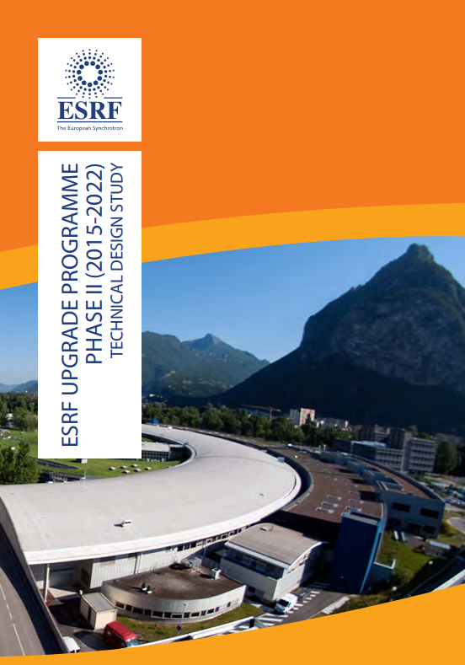
Welcome
Thank you for coming to the
EBS Workshop on Nuclear Resonance Scattering
helping us shaping the scientific case for a new Nuclear Resonance beamline
1987 Red Book
(the final color)
2014 Orange Book

Slide 3
Past and future
ESRF the first 3rd generation synchrotron radiation source
In 1994 first NRS experiments at the TROIKA beamline
NRS users were the first (official) ESRF users
First high pressure experiments
ESRF-EBS shall become the first new generation high-energy
SR source in 2020.
The other three high-energy SR sources have as well launched
Upgrade Programmes and a new source in Bejing is at the
horizon. They all have NRS beamlines.
In that spirit, let us be again fast.
Key features for NRS at the ESRF
Nano-focusing
Micro-eV energy resolution
Timing modes

Slide 4
Thank you

Slide 6
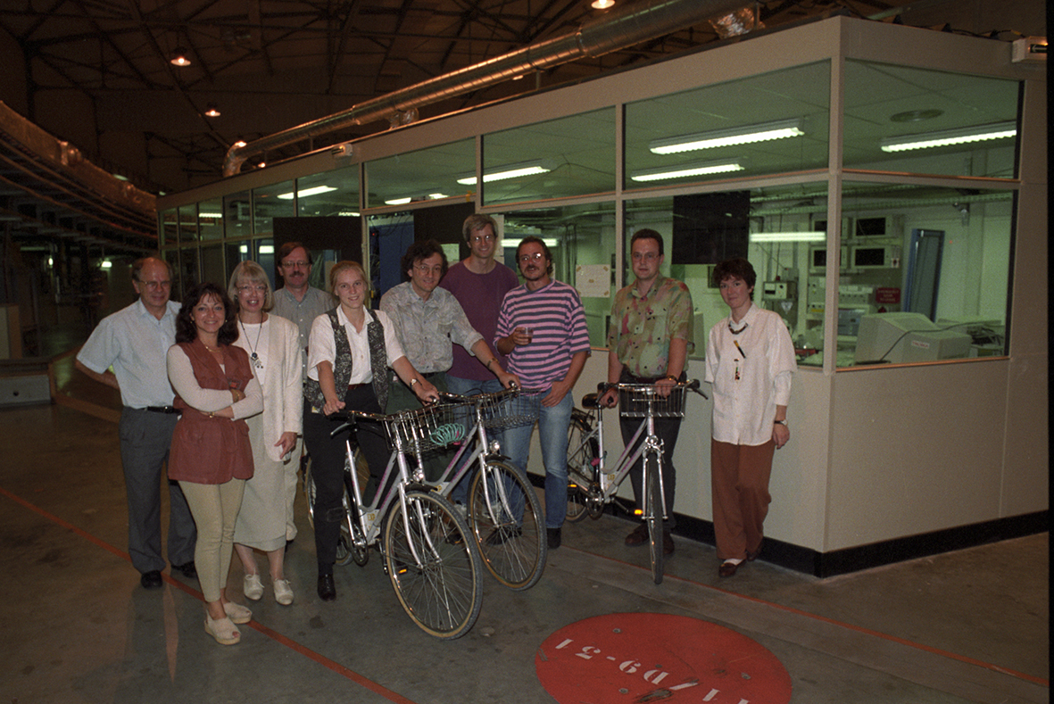
1994 – First Users at ESRF

Slide 7
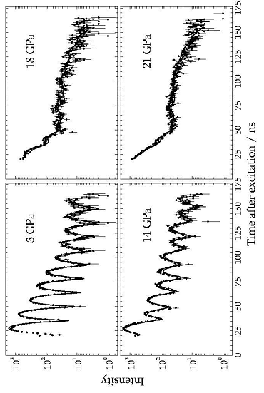
1994 - High pressure
α-iron to ε-iron phase transition monitored by NFS
H.F.Grünsteudel, PhD thesis
Grünsteudel, …, Wortmann Hyperfine Interactions

Slide 9
Mössbauer isotopes
K
Fe
Ni
Ge
Kr
Ru
Sn
Sb
Te
I
Xe
Ta
Os
Ir
Hg
Sm
Eu
Dy
Tm
Yb
XX – with NFS/NIS

